Slide 1

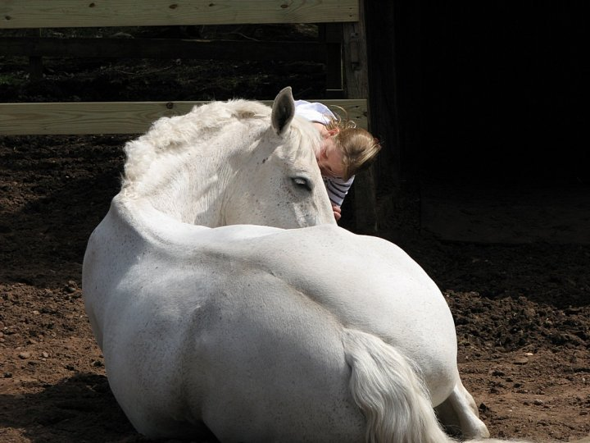


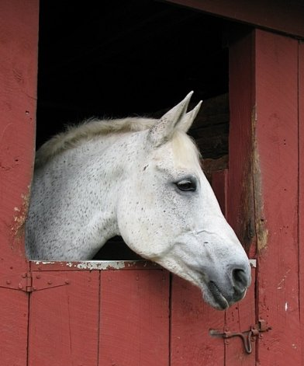
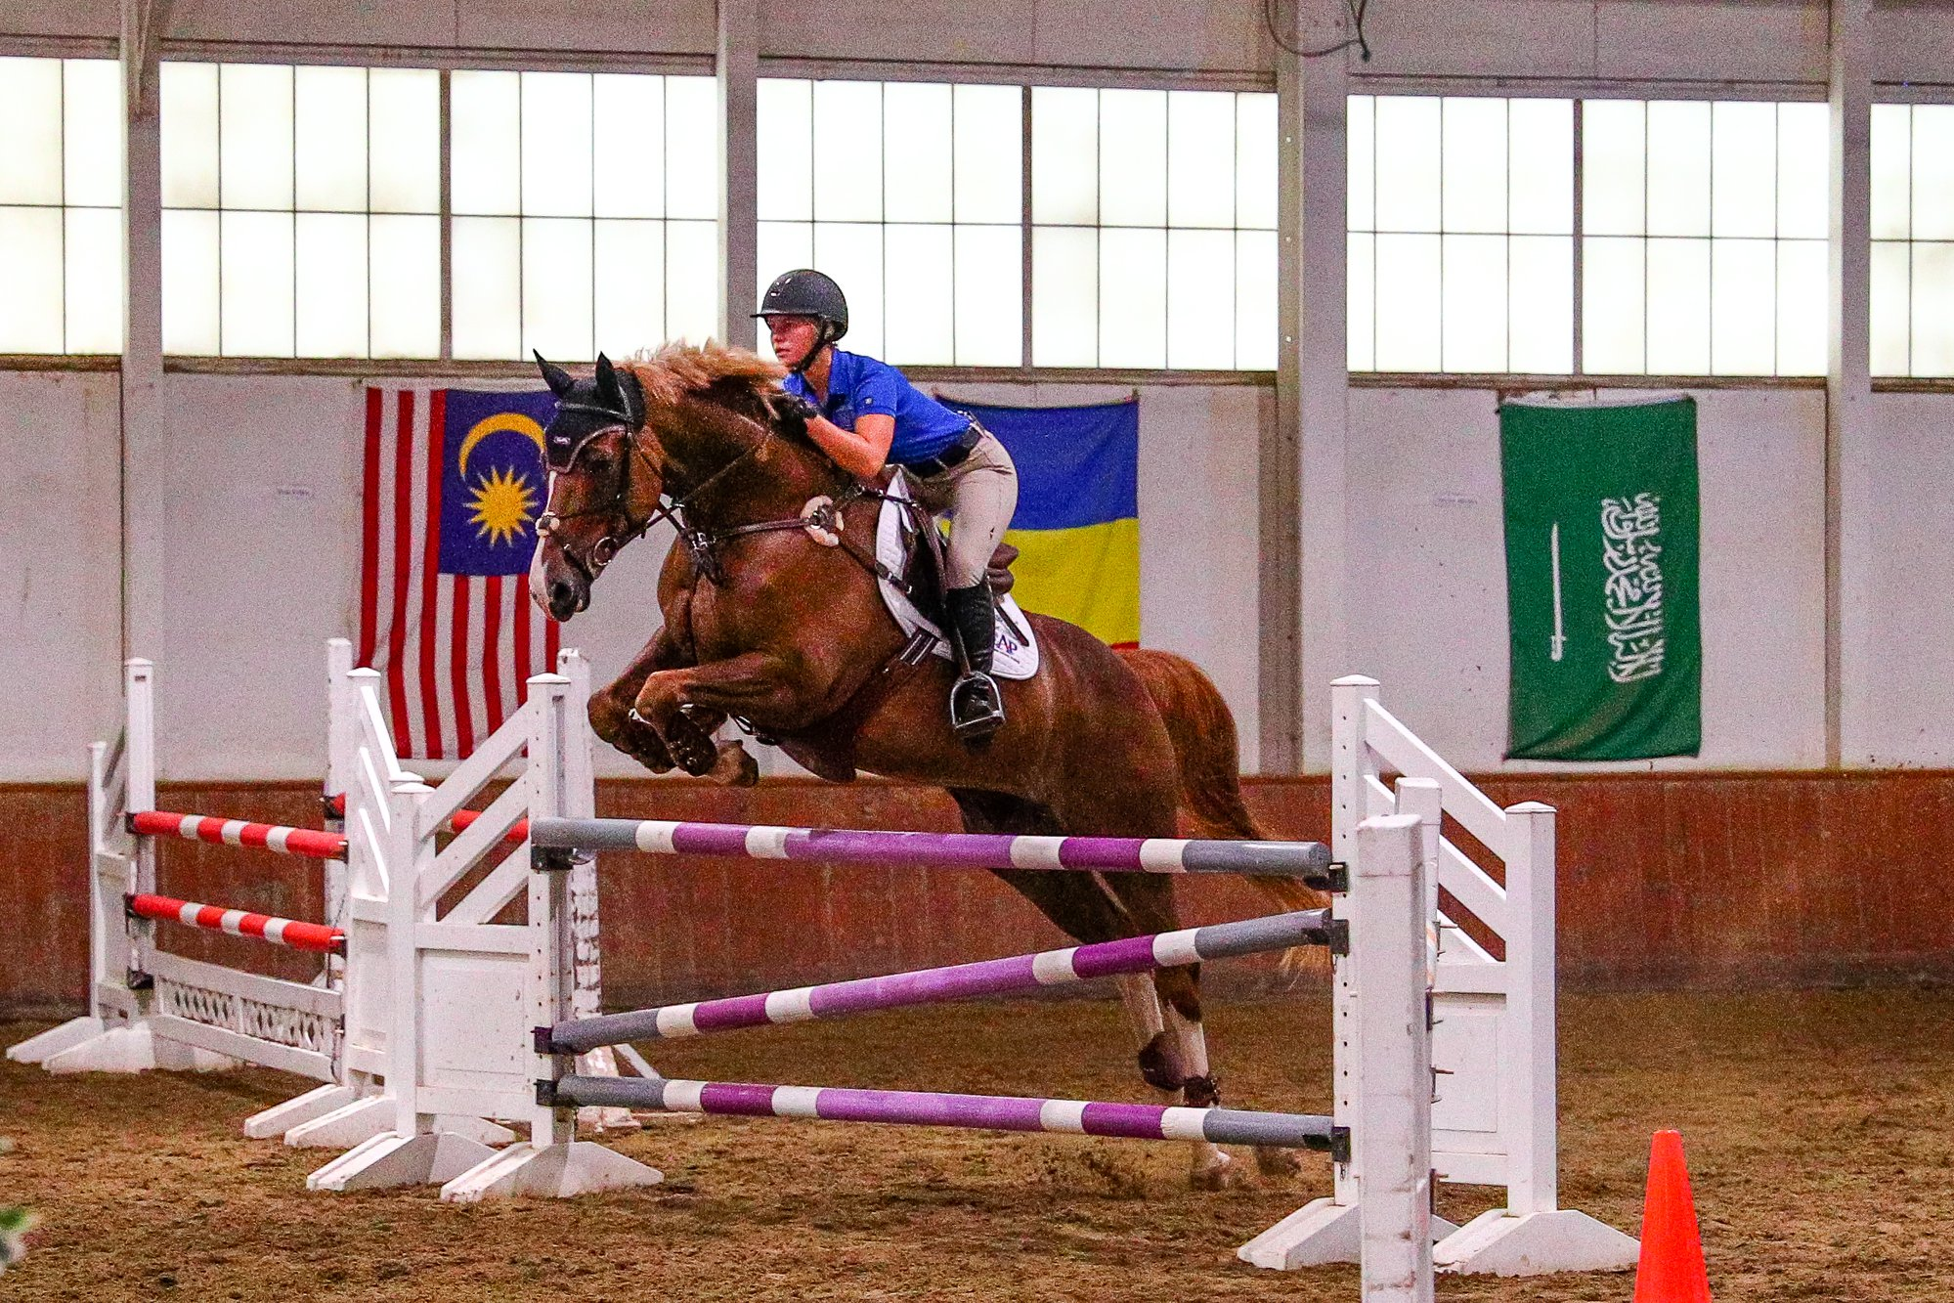

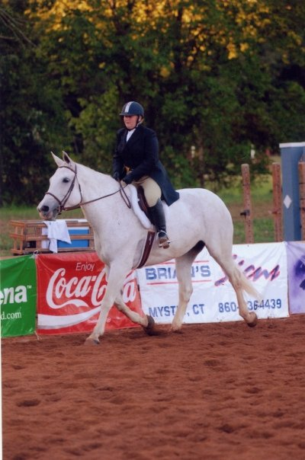
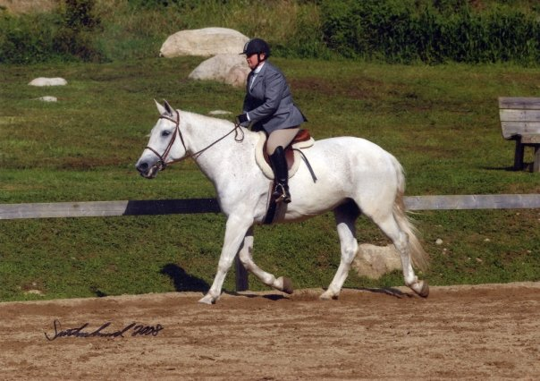
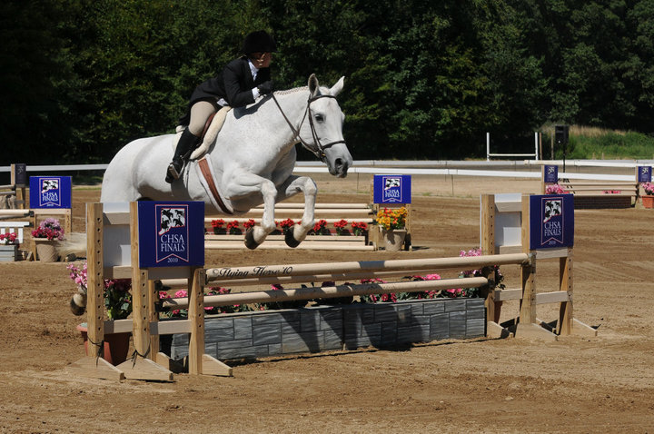


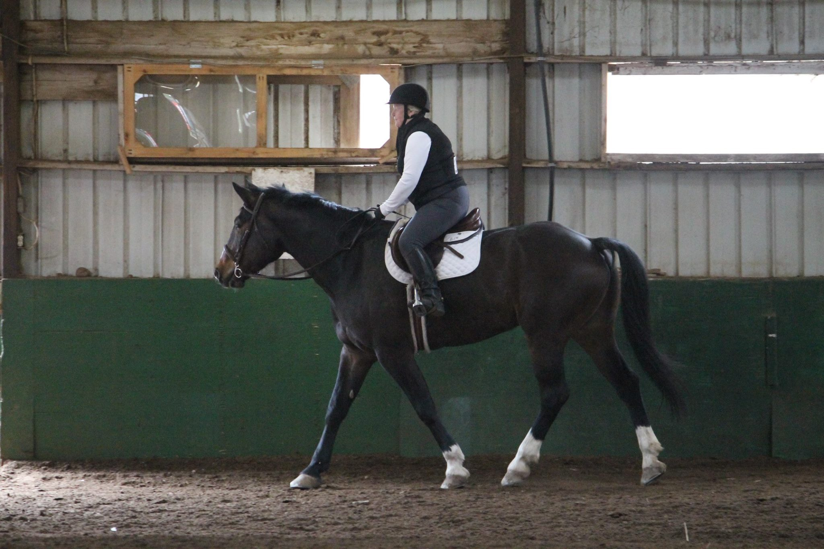
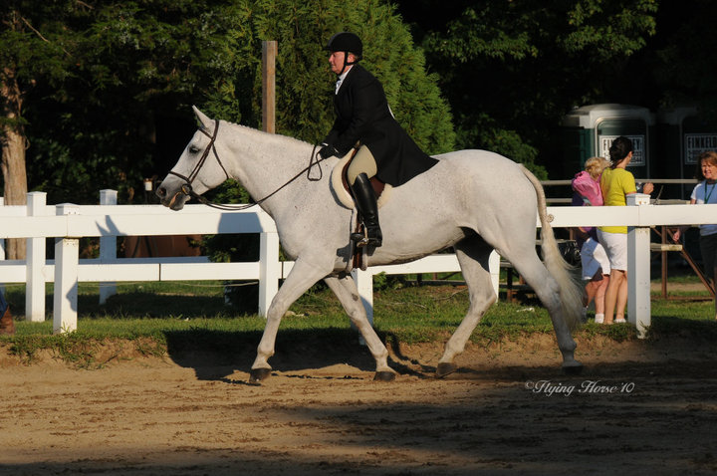


Slide 2
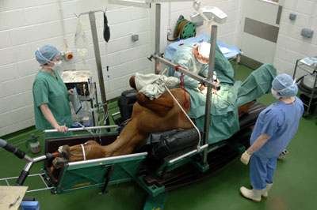
Horse Colic
Joyce Woznica jlwoznic@syr.edu

Slide 3
Agenda
Introduction
Motivation
Problem Statement
Data
Raw Data Description
Data Cleaning and Preparation
Exploratory Data Analysis (EDA)
Next Planned Steps

Slide 4
Introduction
2013:
Colic Surgical Cost $13,500 Estimated 2019 Cost: $17,500
Equine colic is relatively common
“Colic” simply means “abdominal pain”
In horses, it is a severe condition
Horses cannot regurgitate
The horse’s small and large intestine is approximately 84 feet long
There are a variety of different causes of colic, some of which can prove fatal without surgical intervention. Colic surgery is usually an expensive procedure as it is major abdominal surgery, often with intensive aftercare. Among domesticated horses, colic is the leading cause of premature death. The incidence of colic in the general horse population has been estimated between 4 and 10 percent over the course of their lifetime. Clinical signs of colic generally require treatment by a veterinarian.
Notes:
Equine colic is a relatively common disorder of the digestive system. Although the term colic, in the true definition of the word, simply means “abdominal pain,” the term in horses refers to a condition of severe abdominal discomfort characterized by pawing, rolling, and sometimes the inability to defecate.
There are a variety of different causes of colic, some of which can prove fatal without surgical intervention. Colic surgery is usually an expensive procedure as it is major abdominal surgery, often with intensive aftercare. Among domesticated horses, colic is the leading cause of premature death. The incidence of colic in the general horse population has been estimated between 4 and 10 percent over the course of their lifetime. Clinical signs of colic generally require treatment by a veterinarian.
Among the general equine population four to 10 out of every 100 horses experience a colic episode during their lifetime; of these, 1-2% require surgical treatment (2006AAEP Proceedings).
25-30% of horses admitted to the university clinic for colic require surgery while the rest are treated with medical therapy. "In 5-10% of cases a horse is humanely euthanized because of a poor prognosis or economical considerations,
Colic can be divided broadly into several categories [2]:
• excessive gas accumulation in the intestine (gas colic)
• simple obstruction
• strangulating obstruction
• non-strangulating infarction
• inflammation of the gastrointestinal tract (enteritis, colitis) or the peritoneum (peritonitis)
• ulceration of the gastrointestinal mucosa
Types of Colic in Horses
Gas Colic
Gas colic occurs when there is excessive build up of gas within the intestines of the horse. These horses can often have a lot of flatulence.
Spasmodic Colic
Spasmodic colic is the result of intestinal cramps or spasms. This type of colic can also have intestinal hyper motility.
Impaction Colic
Impaction colic accounts for 10% of all colics attended by veterinarians. These occur where partially digested feed, typically roughage, builds up in the large intestine of the horse and stops moving, resulting in a blockage or impaction. With impaction colic, the horse is not passing dung.
Sand Colic
Sand colic occurs in horses living in sandy areas, or horses fed from sandy ground. Fine particle sand builds up in the large intestines resulting in colic.
Twisted Gut
A twisted gut occurs where a portion of the intestine twists on itself (intestinal torsion) or where a portion of intestine inverts into itself (intussusception). This uncommon type of colic accounts for less than 4% of colics overall, but it is very serious and life threatening.
Displacement/Entrapment Colic
Displacements occur when an area of the intestine moves from its normal location in the abdominal cavity to somewhere else, naturally this is not a common type of colic. When the displacements cannot freely move back to its original location, it becomes an entrapment. Displacements and entrapments are very serious because this change in location stretches the blood supply to the area of intestine and can result it being compressed or squashed.
Strangulation Colic
Strangulation colic is very uncommon, but very serious. Strangulation colic occurs when the blood supply to an area of intestines is cut off (strangulated). Cutting off the blood supply, results in rapid death of the intestine wall, a serious life threatening situation.
It is important to realize however, that the vast majority of colics never have their exact causation determined. Happily, this “unidentified type” of colic, also has a recovery rate of over 95%. This can be interpreted as; most horses get a mild form of colic, which is successfully treated by their veterinarian, making further investigation unnecessary.

Slide 5
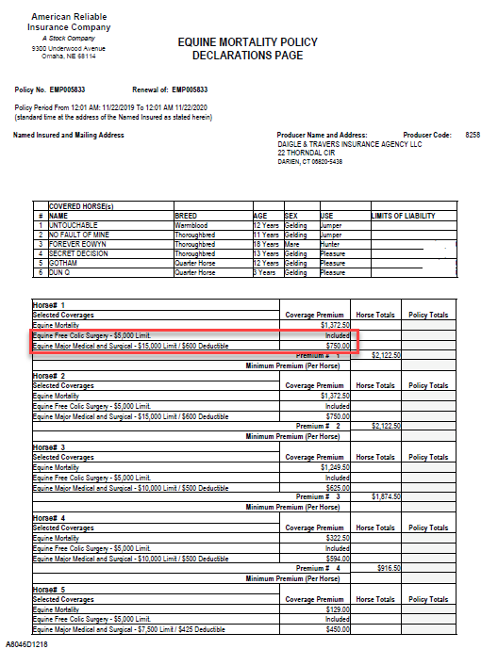

Motivation
I lost a horse to colic
Equine insurance is most often used for colic
Insurance saved my horse’s life the first time
If we could understand when it is going to happen, maybe we can intervene in time

Slide 6
Problem Statement
Given a set of symptoms and horse presentation – Can we predict the outcome of this specific case?
Death
Euthanize
Live
Maybe side effect- can we predict if the horse will need surgery?
Ideally, if we have this information and understand what data is most important in determining the severity of the colic – can we proactively take measures to save the horse.
Notes:
Predict whether or not a horse can survive based upon past medical conditions

Slide 7
Data Table
Variable | Definition
Surgery | yes or no
Age | adult (≥6 months), young (<6 months)
Hospital Number | Case number for hospital (only unique if horse treated one time only)
Rectal Temperature | Rectal temperature in degrees Celsius (normal=37.8)
Pulse | Heartrate in beats per minute (normal 30-40)
Respiratory Rate | Respiration rate (normal 8-10)
Extremities Temperature | Normal, warm, cool, cold
Peripheral pulse | Normal, increased, reduced, absent
Mucous membranes | Normal pink, bright pink, pale pink, pale cyanotic, bright red/injected, dark cyanotic (normal pink to bright pink is normal)
Capillary Refill Time | ≥ 3 seconds, < 3 seconds (< 3 seconds normal)
Pain | Alert (no pain), depressed, intermittent mild pain, intermittent severe pain, continuous severe pain
Peristalsis | Gut Activity. Hypermotile, normal, hypomotile, absent
Abdominal Distension | None, slight, moderate, severe
Nasogastric Tube | Gas coming from tube. None, slight, significant
Nasogastric reflux | None, ≥ 1 liter, < 1 liter
Nasogastric Reflux PH | Scale from 0 to 14 (normal = 7)
Rectal Examination (feces) | Normal, increased, decreased, absent
Abdomen | Normal, other, firm in large intestine, distended small intestine, distended large intestine
Packed Cell Volume | Number of red blood cells by volume (normal is 30-50)
Total Protein | Numeric. (normal is 6-7.5 (gms/dL)
Abdomen Fluid | Clear, cloudy, serosanguinous
Abdomen Fluid PH | Numeric
Outcome | Lived, died, euthanized
Surgical Lesion | Yes, no
Type of Lesion * this is repeated 3 times Lesion1 Lesion2 Lesion3 | 1st Number (site): 1-gastric, 2-small intestine, 3-large colon, 4-large colon and cecum, 5-cecum, 6-traverse colon, 7-retum/descending colon, 8-uterus, 9-bladder, 11-all intestinal sites, 00-none 2nd Number (type): 1-simple, 2-strangulation, 3-inflammation, 4-other 3rd Number (subtype): 1-mechanical, 2-paralytic, 0-N/A 4th Number (code): 1- obturation, 2-intrinsic, 3-extrinsic, 4-adynamic, 5-volvulus/torsion, 6-intussuption, 7-thromboembolic, 8-hernia, 9-lipoma/slenic incarceration, 10-displacement, 0-N/A
Cp_data | Pathology data present? Yes or no

Slide 8
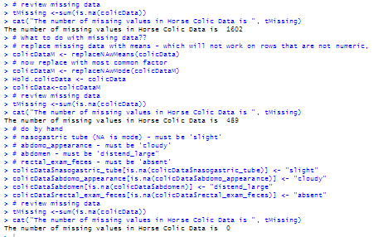
The Data
The data consists of 299 horses with 28 observations sets of observations per horse.
However, one column has 3 or 4 data items grouped together
There is significant missing data (30%)
However, most of the relevant data is there for each horse
Total N/As in data was 1602
Reduced to 0 with mean and mode replacement
Some data is just blank
Lesion2 and lesion3

Slide 9
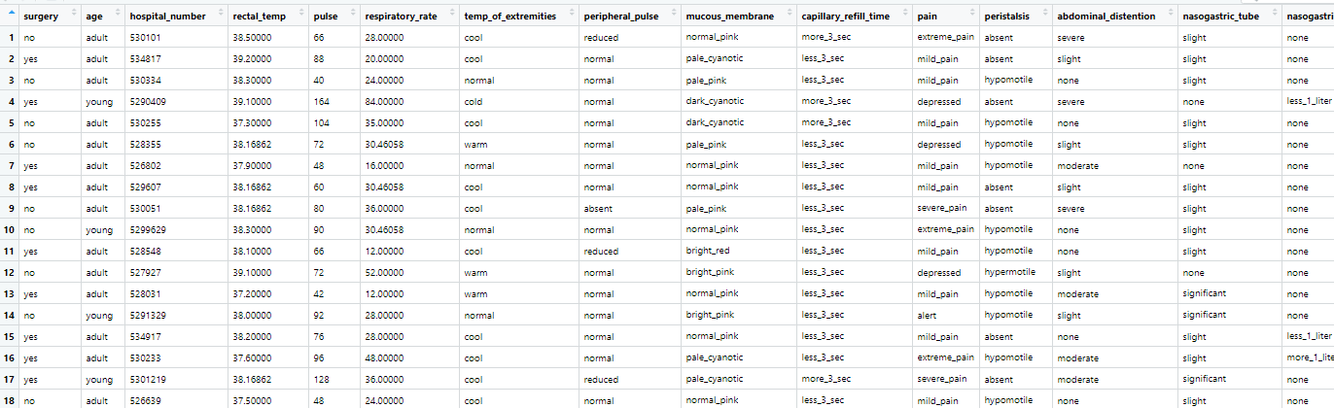
Snipet of Data

Slide 10
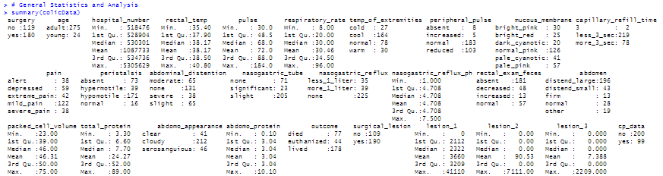
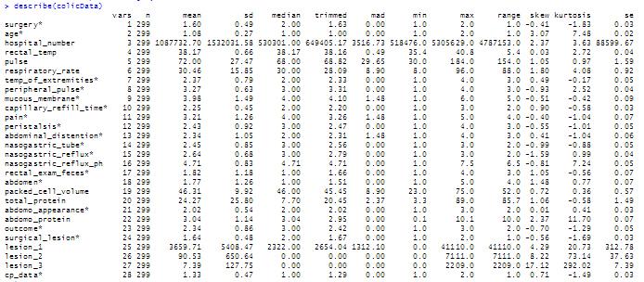
Initial Exploratory Analysis

Slide 11
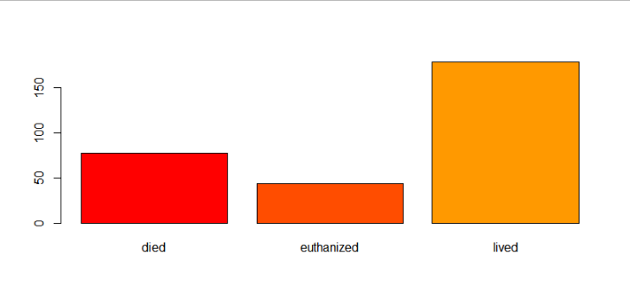
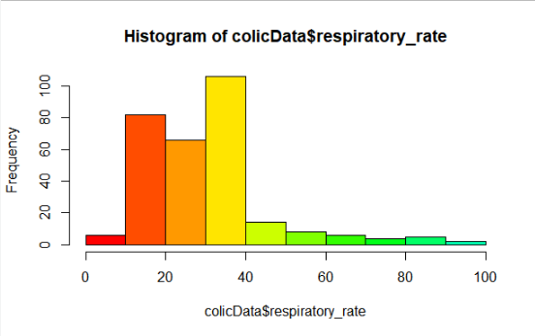
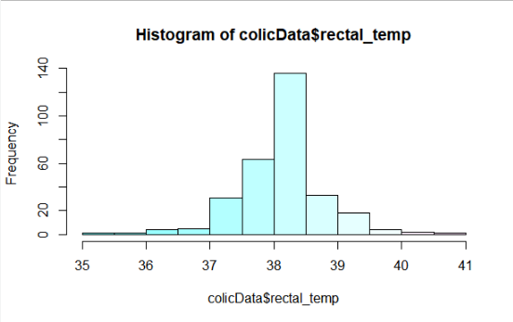
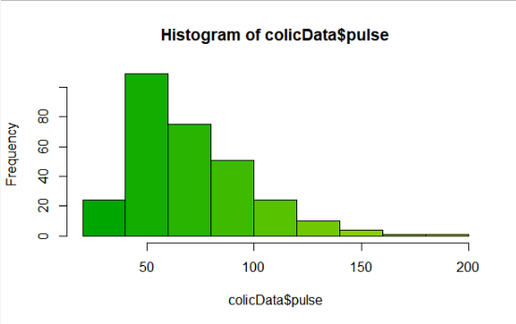
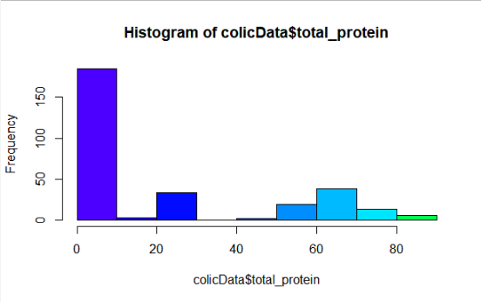
Initial Visualization

Slide 12
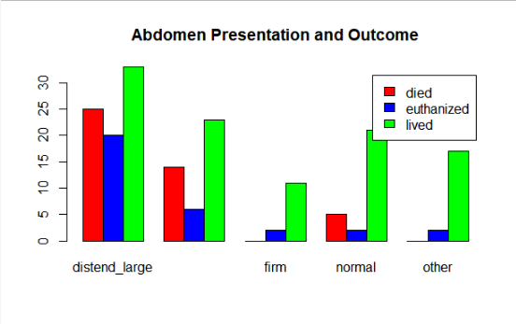
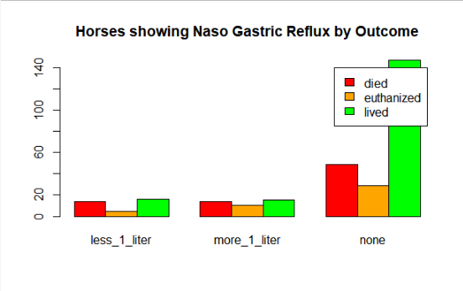
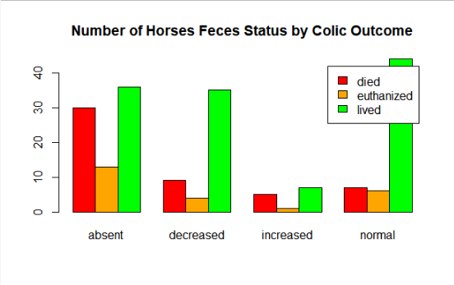
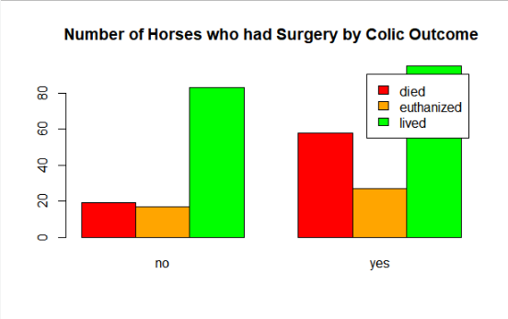
Initial Visualization

Slide 13
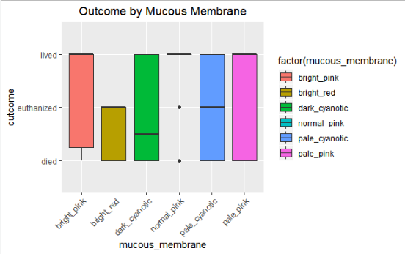
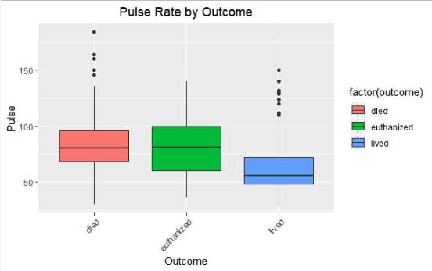
More Visualizations

Slide 14
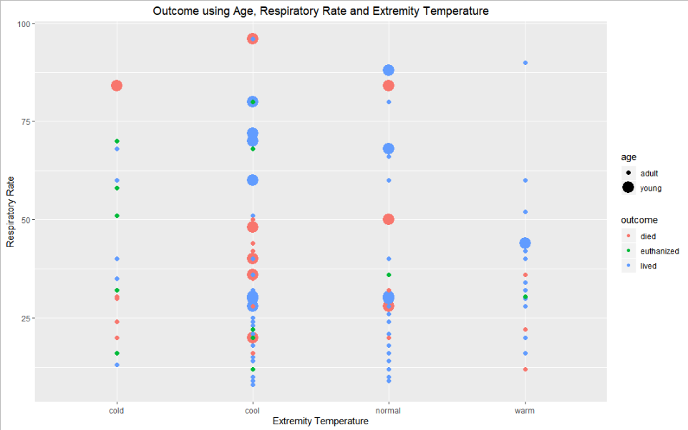
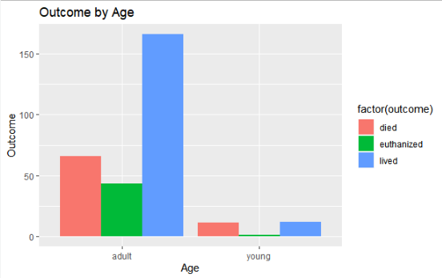
And Even More Visualizations

Slide 15
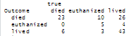
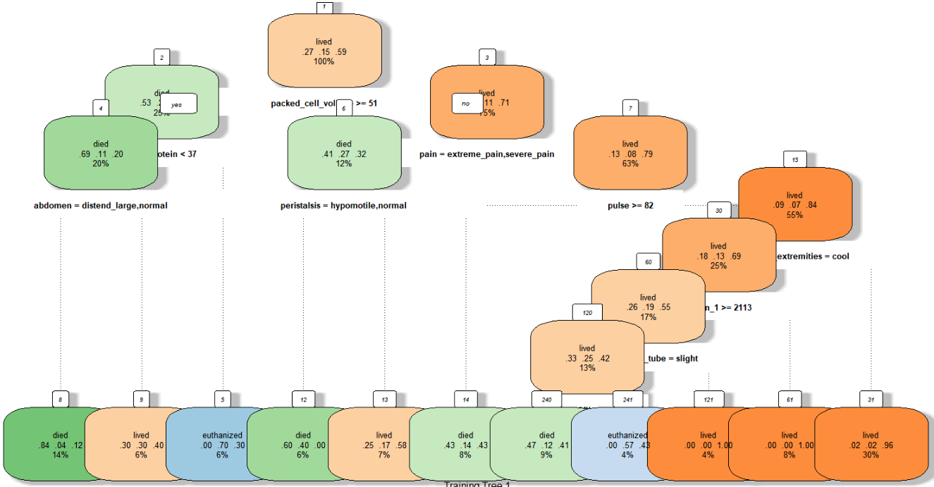
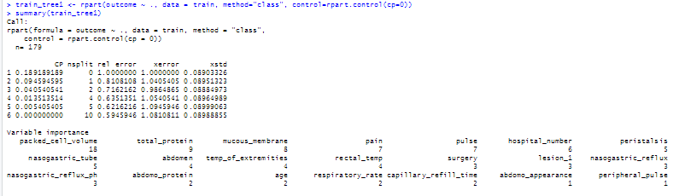
Initial Methods Decision Tree

Slide 16
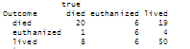
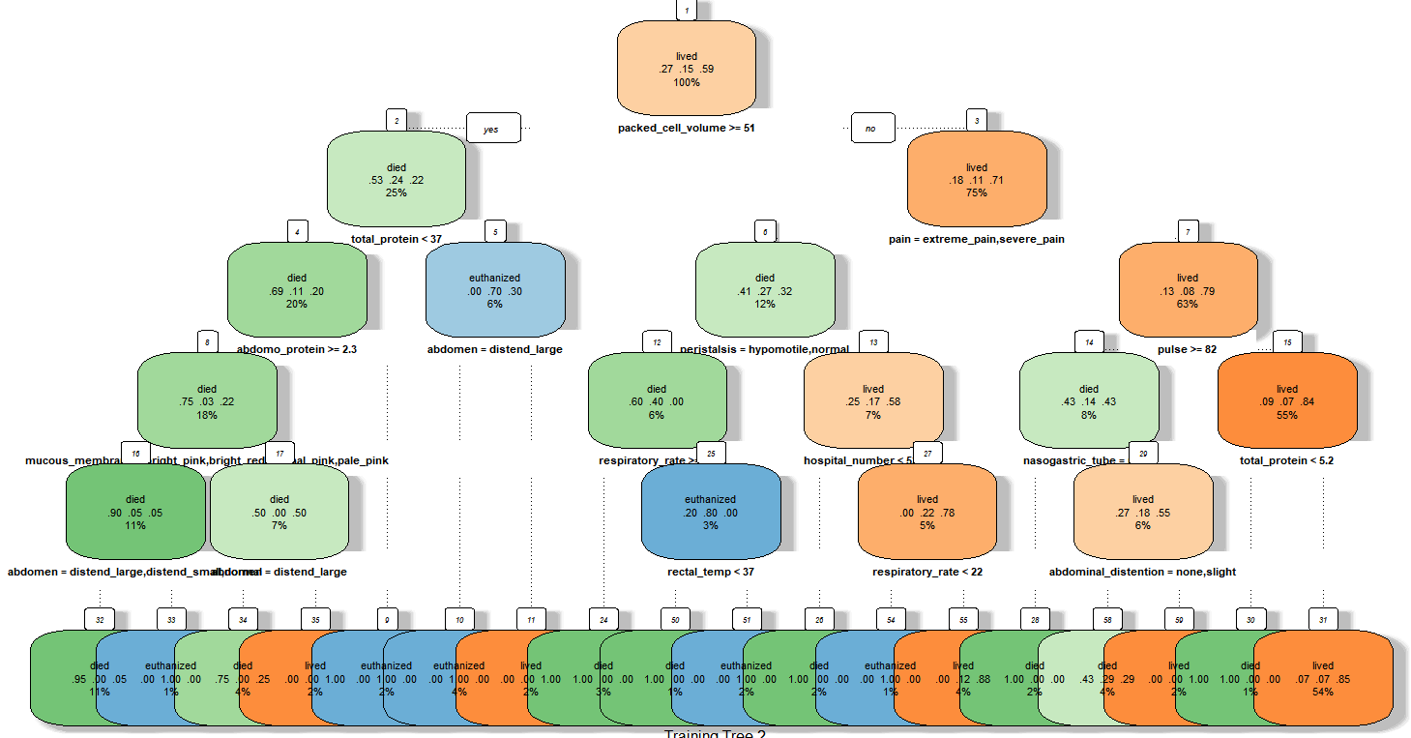
Initial Methods Decision Tree

Slide 17
Approach/Next Steps
Continued Data Clean-up
Remove columns with one or no values
Lesion_2
Lesion_3
Split combined lesion numbers into separate columns
Convert factor data to numeric for clustering?
Modeling/Prediction
Fine Tune Decision Tree
Clustering, if possible
Association Rule Mining?
Naïve Bayes
SVM
Notes:
Clustering is a method of un-supervisory learning and a common technique for data analysis used in many fields, including machine learning, data mining, pattern recognition, image analysis and bioinformatics. Clustering is a division of data into groups of similar objects. Clustering can be used to group the patern which are suffering from disease or not suffering. Each group, called a cluster, consists of objects that are similar between them- selves and dissimilar compared to objects of other groups. The following diagram in Figure 2 represents the clustering process [14]:

Slide 18
Conclusions
Data is very old
Things not captured that would have helped

Slide 19
References
This dataset was originally published by the UCI Machine Learning Database: http://archive.ics.uci.edu/ml/datasets/Horse+Colic
Title: Horse Colic database
Source Information:
Creators: Mary McLeish & Matt Cecile Department of Computer Science University of Guelph Guelph, Ontario Canada N1G 2W1
Donor: Will Taylor (taylor@pluto.arc.nasa.gov) Date: 8/6/1989
Referenced information for developing this project
Notes:
1. TItle: Horse Colic database 2. Source Information -- Creators: Mary McLeish & Matt Cecile Department of Computer Science University of Guelph Guelph, Ontario, Canada N1G 2W1 mdmcleish@water.waterloo.edu -- Donor: Will Taylor (taylor@pluto.arc.nasa.gov) -- Date: 8/6/89

